Slide 1
TIME-SERIES MACHINE LEARNING
Electricity Demand
Forecasting with XGBoost
Short-interval demand prediction · Presented by Krish Bhatia
Python · Pandas · XGBoost · Scikit-learn · Jupyter
Notes:
This project predicts electricity demand from historical patterns, calendar information and temperature. The focus is short-interval forecasting with an engineered tabular feature set.

Slide 2

FORECASTING TASK
Predicting demand
5 minutes at a time
5-minute
Forecast intervals
Historical demand, calendar information and temperature become inputs to future power requirements.
Capture temporal patterns and demand dependencies as demand shifts through the day.
Notes:
The core problem is to predict future demand from past patterns and external factors. Five minutes describes the forecast interval; it does not by itself establish the forecast horizon.

Slide 3

PROJECT OBJECTIVES
Seven objectives, from analysis to a reusable model
1
Analyze historical demand patterns
2
Run exploratory analysis and visualization
3
Extract time-based features
4
Create lag and autoregressive features
5
Train an XGBoost regression model
6
Evaluate with MAE and RMSE
7
Save the trained model for reuse

Slide 4
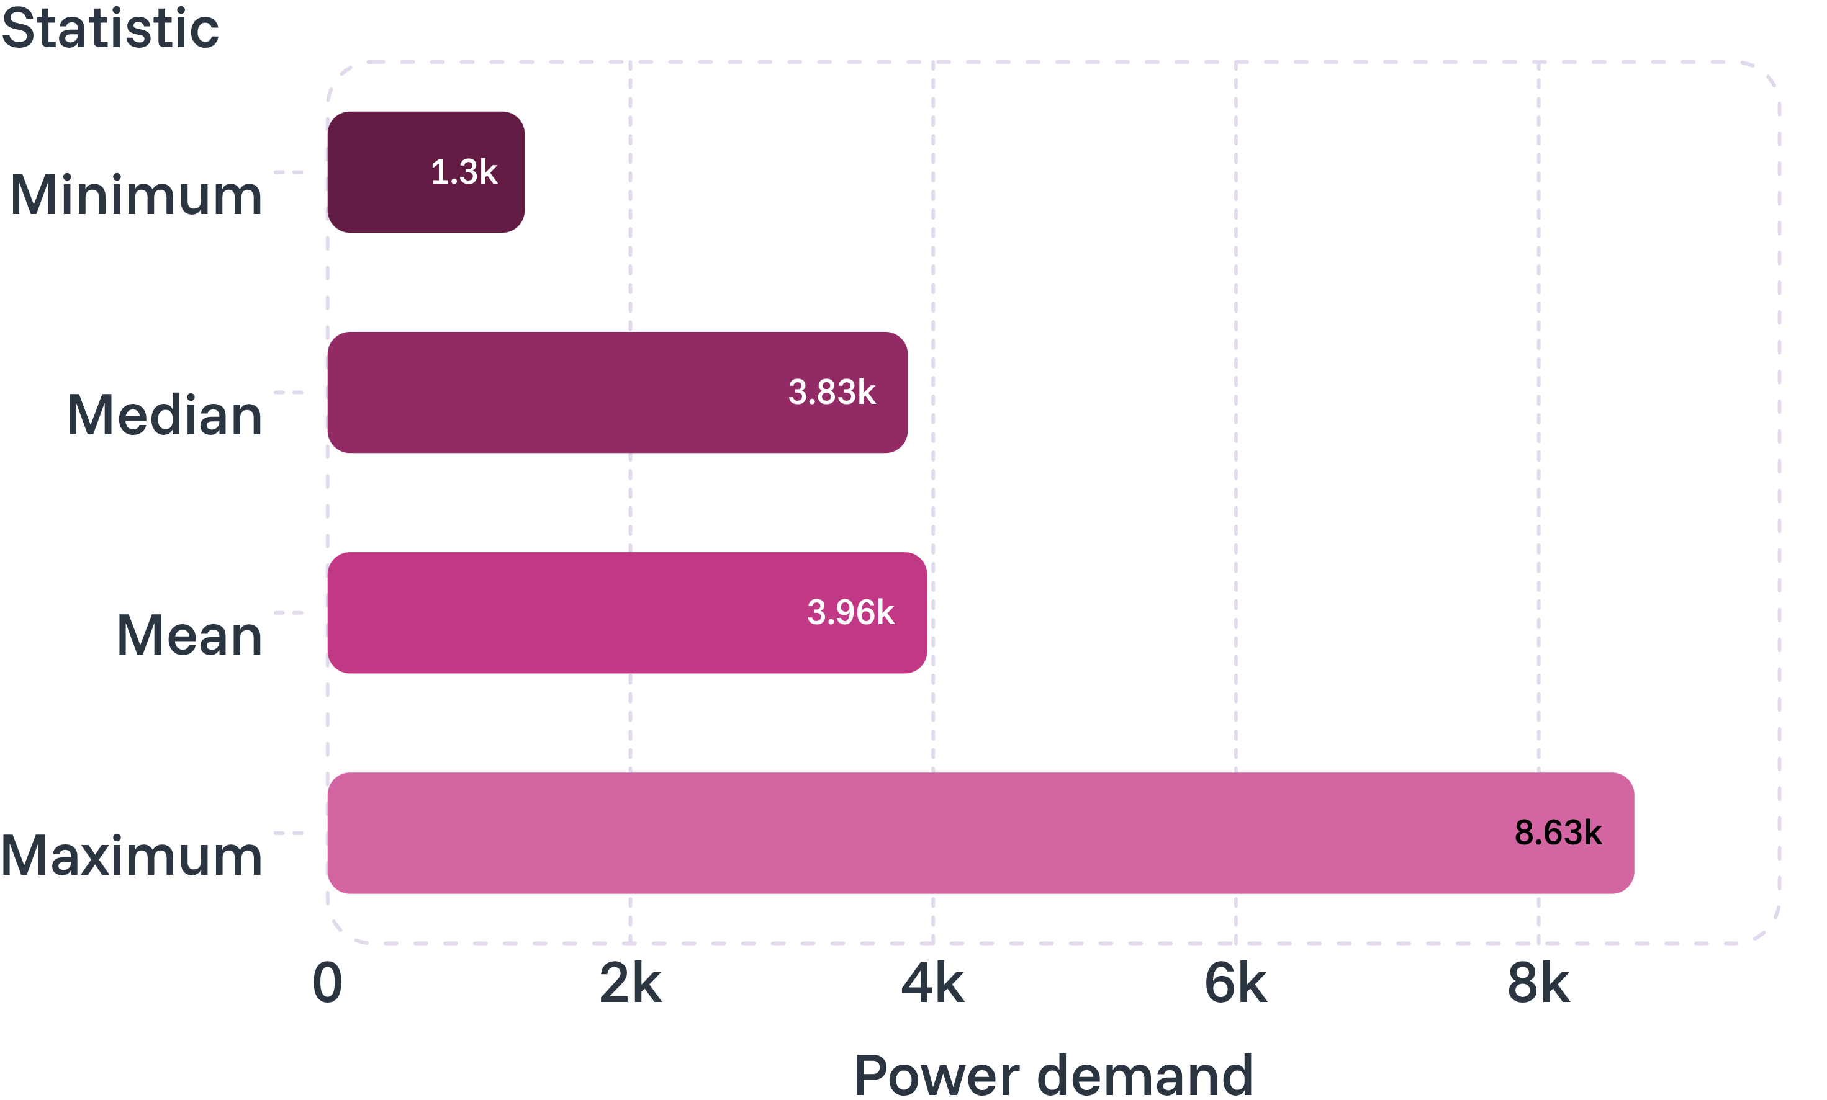
DATASET · JAN 2021 TO DEC 2024
393,440 observations across four years
393,440
Observations · 15 variables
Every 5 minutes
Target: power demand
Temperature and historical demand included.
Raw dataset excluded from GitHub because of its size.
Demand statistics across the raw dataset.

Slide 5
EXPLORATORY ANALYSIS
Exploring the patterns behind demand
Turn observed patterns into predictive features.
When does it change?
What is typical?
What moves together?
Demand over time, by day and by month.
The distribution of demand and its extremes.
Temperature relationships and correlations between variables.
Time-series plots · Monthly distributions
Demand distribution
Temperature vs. demand scatter · Correlation heatmap
Notes:
These are the questions and visual analyses used in exploration, rather than claims about patterns not supplied here. The purpose is to identify useful temporal and external predictors.

Slide 6
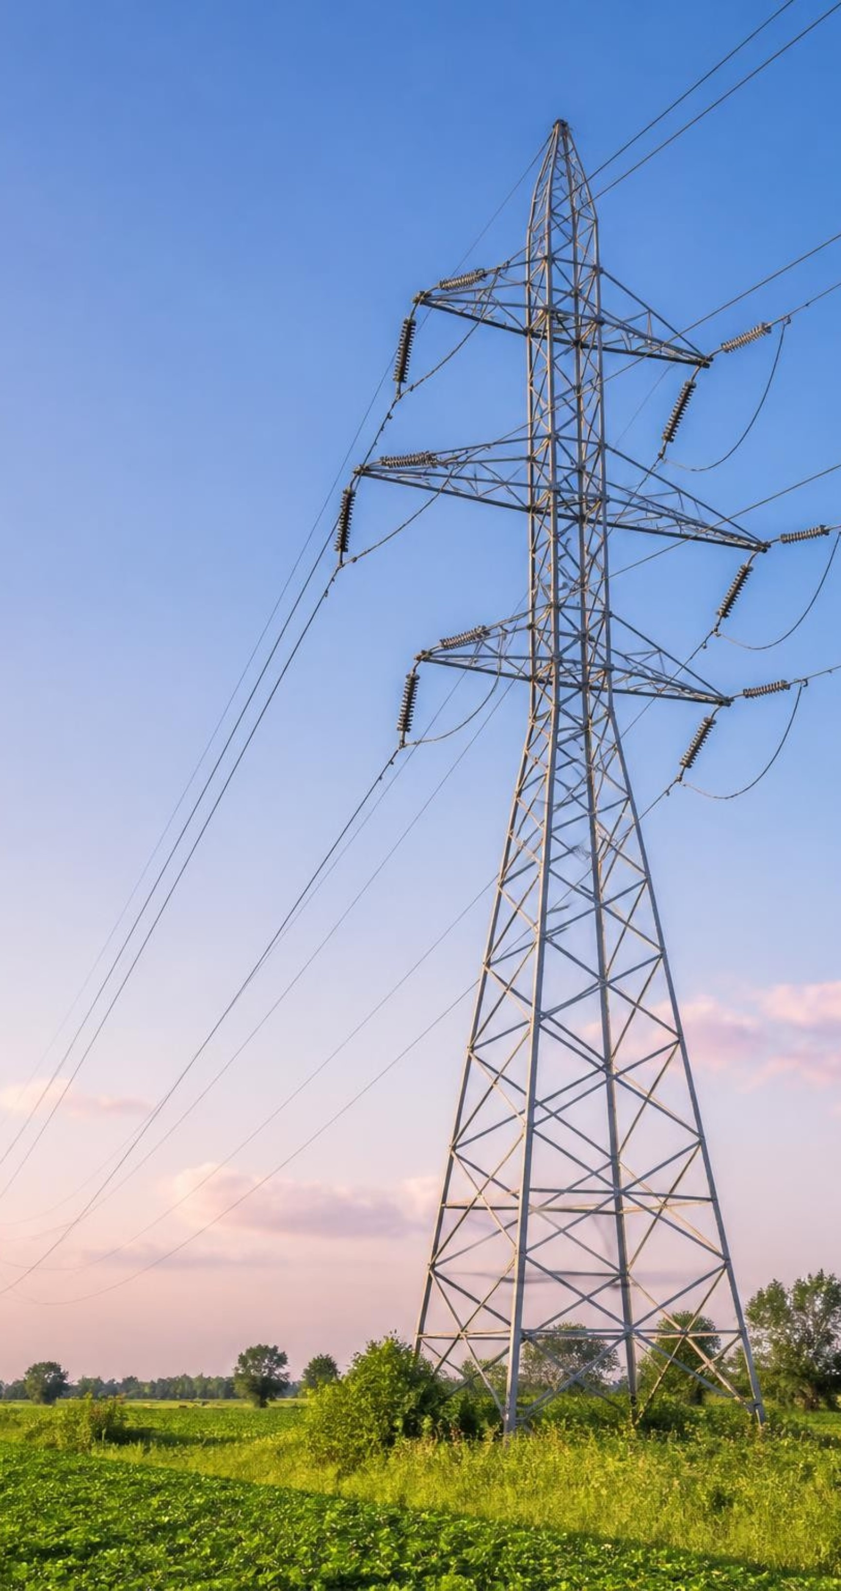
FEATURE ENGINEERING
Features that capture recent and recurring demand
Calendar
year, month, day, hour, minute, week of month, day of week, weekend flag
Historical demand
Lag_5min, Lag_1hour, Lag_1day, Lag_1week, mean_last_hour
Weather
temperature
Lags capture dependence on recent and recurring history.

Slide 7
MODELING WORKFLOW
From raw data to evaluated forecast
01
02
03
04
Raw data
and cleaning
Timestamp
processing
Exploratory
analysis
Feature engineering
and lag creation
05
06
07
Chronological
train/test split
XGBoost model
and prediction
MAE and RMSE
evaluation
The split is chronological, not random, because this is time-series forecasting.

Slide 8
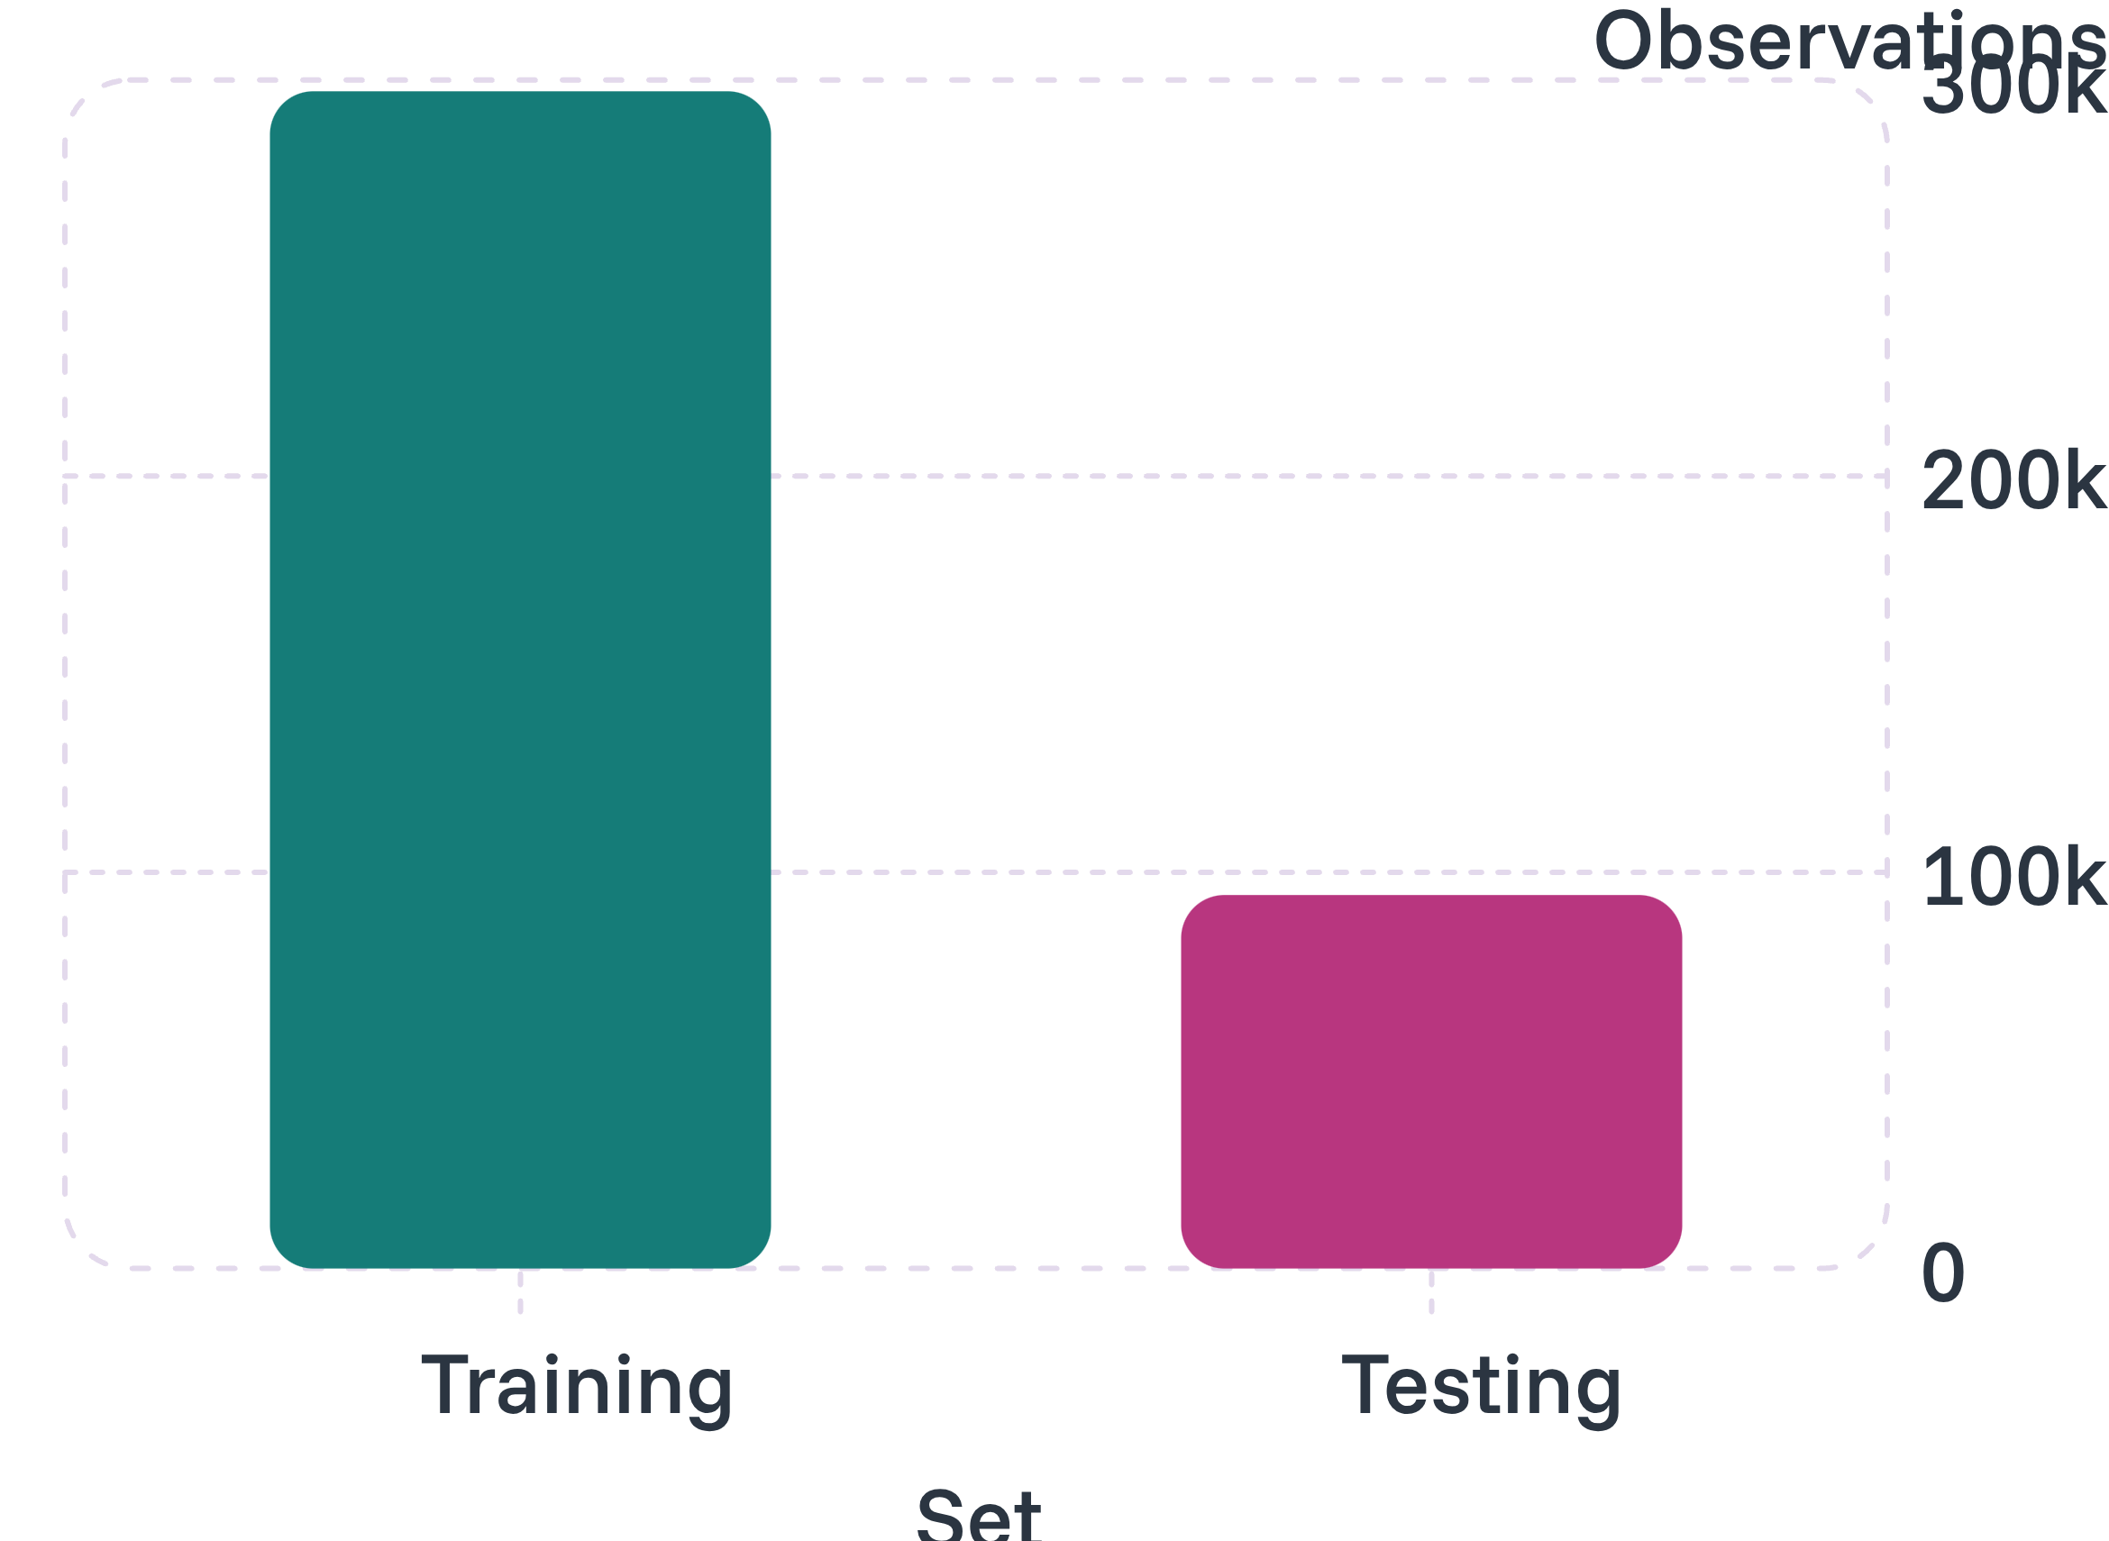
OUT-OF-TIME EVALUATION
Train on the past, test on the future
297,159
Training · Jan 2021 to Dec 2023
94,265
Testing · Jan 2024 to Dec 2024
Random mixing of past and future would cause data leakage.
Notes:
About 76% of the supplied split observations are used for training and 24% for testing. These split counts are distinct from the raw dataset count; no reason for that difference was supplied. Chronological separation preserves the direction of forecasting.

Slide 9
MODEL SELECTION
Why XGBoost fits this problem
Nonlinear relationships
Tabular data
Work directly with structured feature columns.
XGBRegressor
Learn demand responses beyond a straight line.
n_estimators=1000
learning_rate=0.01
early_stopping_rounds=50
random_state=42
objective
reg:squarederror
Feature interactions
Engineered time series
Combine calendar, history and weather signals.
Use lag and recurring-demand features.

Slide 10
RESULTS · UNSEEN 2024 DATA
MAE 42.32 and RMSE 117.79
on unseen 2024 data
MEAN ABSOLUTE ERROR
ROOT MEAN SQUARED ERROR
42.32
117.79
Predictions differ from actual demand by about 42.32 units on average.
Penalizes larger errors more heavily.
The notebook compares actual vs. predicted demand over the test period.
Notes:
Read the two metrics separately. MAE expresses average absolute error in demand units. RMSE gives greater weight to larger misses. The supplied results do not include a baseline comparison, so these values alone do not establish relative model superiority.

Slide 11

Limitations & Future Work
Current Limitations
Current setup is one-step-ahead forecasting.
Future lag values become challenging for multi-step forecasting.
No rolling-origin cross-validation has been performed.
Holiday information is not currently included.

Slide 12
Conclusion
Built an end-to-end electricity demand forecasting pipeline.
Processed high-frequency 5-minute demand data.
Used calendar, temperature, and historical demand features.
Applied XGBoost regression for forecasting.
Achieved:
  MAE: 42.32
  RMSE: 117.79
Saved the trained model for future reuse.
Final Takeaway
Historical demand patterns combined with time-based and weather features can be effectively used with XGBoost for short-interval electricity demand forecasting.

Slide 13
Thank You
Any Questions?
Krish Bhatia
Electricity Demand Forecasting with XGBoost

